Slide 1
Introduction to RTX Kernel
Round-Robin Algorithm

Slide 2
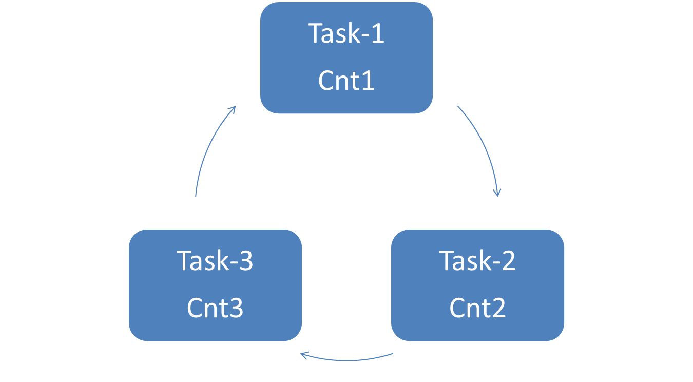
Round-Robin Scheduling
System

Slide 3
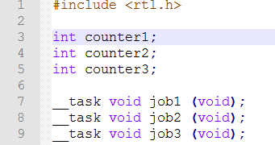



Slide 4
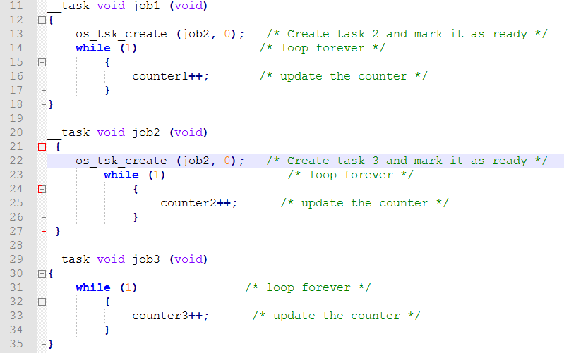

Slide 6
Thank you

